Slide 2

Advancing learning, certifying your future
Notes:
2

Slide 3
Enhancing Quality of Assessment through Implementation of a Quality Management System Based on ISO 9001: BEC – Case Study
SAAEA Conference,
Botswana, May 2019
Mothusi Nicholas NTAU

Slide 4
Presentation Outline
Introduction
  BEC Mandate
  Mission & Vision
  Strategic Objectives
Paper Objectives
Content Analysis
Literature Review
How QMS Enhanced BEC Business
Conclusions
Recommendations

Slide 5
Introduction
The BEC was established through the BEC Act No. 11 of 2002 as a Corporate Body governed by a Board (also referred to as “Council”) appointed by the Minister of Basic Education.
Mandate: To conduct national school examinations and any other examinations and issue certificates in respect of these examinations.

Slide 6
Introduction
The national school examinations are:
Primary School Leaving Examination (PSLE);
Junior Certificate Examinations (JCE); and
Botswana General Certificate of Secondary Education (BGCSE).

Slide 7
BEC Mission & Vision
Mission: Provision of a credible and responsive assessment and examination system.
Vision: To be a provider of accessible and globally competitive qualifications.
Core Values:
Excellence
Integrity
Transparency
People Focus

Slide 8
BEC Strategic Objectives
Improve competitiveness and relevance of our qualifications;
Improve financial performance;
Improve assessment services;
Improve business processes;
Improve access to products and services;
Improve use of technology;

Slide 9
BEC Strategic Objectives
Improve knowledge skills and organisational re-design;
Improve work environment by development and implementation of policies; and
Improve governance through compliance to corporate governance standards.

Slide 10
PAPER OBJECTIVES
  Discuss the challenges of BEC in implementing a quality management system and how such were overcome.
  Establish if BEC as an assessment institution has benefited from ISO 9001 implementation.
  Make recommendations to other assessment bodies and large institutions with regards to implementation of the quality management system.

Slide 11
CONTENT ANALYSIS
This paper presents a case study on BEC’s journey for implementation of ISO 9001 international standard.
Methodology adopted is that of reviewing existing literature on researches on the subject matter as well as the BEC documentation.
Conclusions are drawn based on the material considered.
It should be noted that the conclusions drawn are mostly indicative and further research may be necessary to validate some of the findings.

Slide 12
LITERATURE REVIEW
PwC US Report authored by Ribeiro et al (2016) made the following findings:
70% believe changes in industry regulation will become a disruptive factor - resulting in the need for transformation.
58% of companies no longer focus on continuous improvement of existing processes alone, but instead focus on transformational change.
Only 36% of companies prioritize a few cross-functional capabilities at the company level and expect functional leaders to identify how they contribute to the mission.

Slide 13

LITERATURE REVIEW
PwC US Report, Ribeiro et al (2016):
55% of companies work in silos, with each function making its own decisions on which capabilities matter most.
61% say the solution to reaching their strategic goals is collaborating more across functions, paired with faster decision making.
Source: www.madteams.org

Slide 14
LITERATURE REVIEW
King and Lenox (2001):
Adoption of ISO 9001 leads production plants to reduce waste generation and toxic chemical emissions, suggesting that implementing the quality management standard has positive spillover effects that can improve environmental management practices.
British Standards Institute (2016):
Over 82% of BSI clients that embraced ISO 9001 gained benefits from such certification:
66% improved quality of their products or services
60% reduced the likelihood of mistakes
57% attracted new customers

Slide 15
LITERATURE REVIEW
Stojanovic (2015):
External demands on the education system are increasing; putting pressure on the deployment of resources and the efficiency of the organization.
The continuing education and training sector is becoming a more mature and “established” economic sector, alongside many other service sectors.
These trends suggest that the education and training paradigms are changing from supply-driven teaching to demand-led learning.
Many educators do not feel comfortable with such developments.

Slide 16
LITERATURE REVIEW
ISO 9001 has been shown to provide organizations with the following benefits:
Consistent, repeatable processes and a common system.
Fewer service or product failures.
Employees know what to do and how you want it done.
More business, because you can sell to new markets or because having the endorsement will distinguish you in the marketplace.
Quick detection if things are going wrong, and where; you stop spending money or wasting time on the same old problems. Many problems disappear because they are prevented.
Better management control and reporting – which means that you know how your business is doing.

Slide 17
HOW QMS ENHANCED BEC BUSINESS
2009
ISO 9001:2008 Implementation Project initiated
Feb 2017
BEC Certified to ISO 9001:2008 by Botswana Bureau of Standards
Apr 2017
ISO 9001:2015 Implementation Project initiated

Slide 18



ISO 9001:2008 CERTIFICATION

Slide 19
ACHIEVEMENTS
Set-up QMS in accordance with ISO 9001:2008.
Train staff on requirements of ISO 9001:2008.
Conduct change management activities from time to time to ensure buy-in and understanding of roles and responsibilities by staff.
Develop, implement and maintain QMS documents such as Quality Policy, Quality Manual, Procedures, Forms, etc. necessary for effective implementation of the QMS.
Develop, implement and maintain Resource Management Processes necessary for effective implementation of other QMS operational processes.
Conduct internal audits and implement of corrective and preventive actions.
Conduct Management Review and ensure continual improvement.

Slide 20
CHALLENGES
Resistance to change – this was however overcome by undertaking change management activities such as workshops (“Change Fridays”) to ensure buy-in and understanding of roles and responsibilities by staff.
Unavailability of auditors and auditee personnel for conduct internal audits at scheduled time due to other work commitments.
Drafting Directorate Management Reviews was initially not fully owned by the respective Heads as it considered to be the job of the Quality Assurance Division. It was therefore challenging to document required information for analysis.

Slide 21
MANAGEMENT REVIEW
Management Review Report is prepared by compiling Directorate QMS Review Reports.
Each Process Owner (Division/Directorate) should prepare the most recent data on process performance in their area of responsibility. This data should be shared with the management team.
Management Reviews may include, but are not limited to the items identified below:

Slide 22
MANAGEMENT REVIEW
Review of the Quality Policy
Status of Actions from Previous Management Reviews
Changes in External and Internal Issues Relevant to the QMS
Information on the Performance and Effectiveness of the QMS Including Trends
Customer Satisfaction and Feedback
Extend to which Quality Objectives have been Met
Process Performance and Conformity of Products and Services
Nonconformities and Corrective Actions
Monitoring and Measurement Results
Audit Results
Performance of External Providers

Slide 23
MANAGEMENT REVIEW
The Adequacy of Resources
The Effectiveness of Actions Taken to Address Risks and Opportunities
Opportunities for Improvement
Any Need for Changes to the Quality Management System
Resource Needs

Slide 24
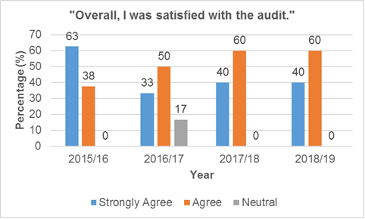
MANAGEMENT REVIEW
Figure 3 – QMS Audit Customer Satisfaction Trends
Figure 3 above reflects that over the years customers were generally satisfied with the audits since none of them disagreed with the statement.

Slide 25
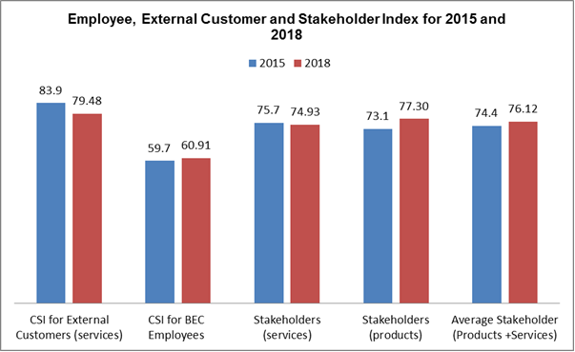
MANAGEMENT REVIEW
Figure 4 – Employee, External Customer and Stakeholder Index for 2015 and 2018
CSI for BEC Employees, Stakeholders (products), Av. Stakeholder (Products + Services)

Slide 26
MANAGEMENT REVIEW
Figure 6 – Employee Performance Trends (2014-2018)
Improvement in employee performance from annual average score of 103.2 to 104.7

Slide 27
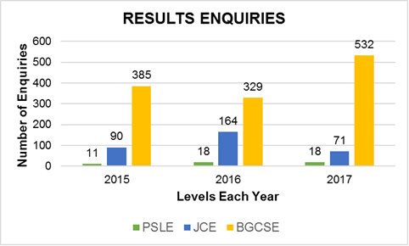
MANAGEMENT REVIEW
Figure 13 – Results Enquiries (2015-2017)
Increasing number of results enquiries from a total of 486 in 2015 to 621 in 2017. This was as a result of increased customer awareness about their rights and BEC processes

Slide 28
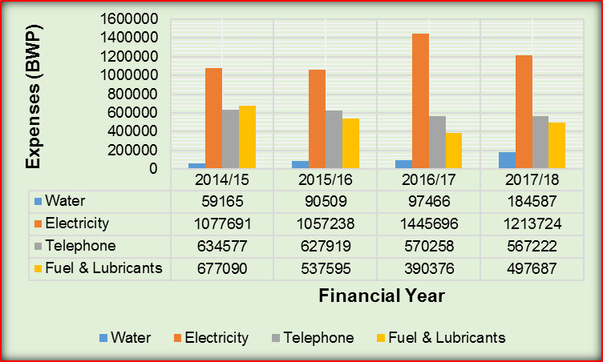
MANAGEMENT REVIEW
Figure 17 – Utility Bills (2014-2018)
There has been a general increase in the total utility bills due to varying reasons.
Management had an opportunity to appreciate the challenges and collectively decide on measures to reduce utility cost where possible.

Slide 29
MANAGEMENT REVIEW
Figure 19 – Internal QMS Audit Findings (2016-2018)
Decreasing number of QMS audit findings between 2016 and 2018. This reflects a declining number of ‘problems’ as BEC QMS matures.

Slide 30
CONCLUSIONS
Average Employee Performance steadily improved from annual average score of 103.2 to 104.7 between 2014 and 2018.
Increasing number of results enquiries as a result of increased customer awareness about their rights and BEC processes.
QMS Management Review enables cross-functional engagements and collective management decision-making (reduction of silo-effect).
QMS enables staff to know how their processes affect the performance of other functions (process approach).

Slide 31
RECOMMENDATIONS
Assessment bodies should consider implementing ISO 9001 international standard as a basis for its quality management system in order to enhance the quality of their services.
Assessment, education and training sectors should be more customer-centric to keep up with changing customer needs.

Slide 32
THANK YOU!!!

